Slide 1
IST 659 Final Project:
Open Library
A public library database
Team Librarians
Abhijith Vamadev, Kelvin Nyamalor

Slide 2
Problem Application: Open Library
Key Stakeholders:
Members
Employees
Key Information:
Book Information
Book_title, type of book, authors of different books
Member information and reservation information
Who, what, when, what type of books reserved and who reserved
Employees
Who are the employees, how many student employees, hours worked

Slide 3
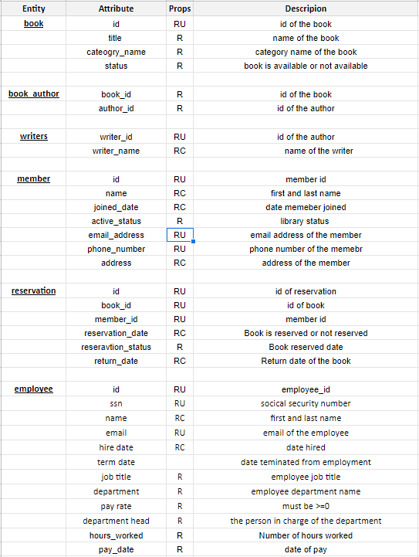
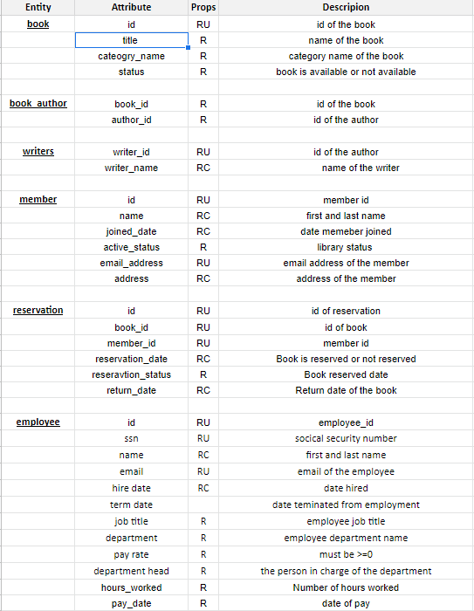
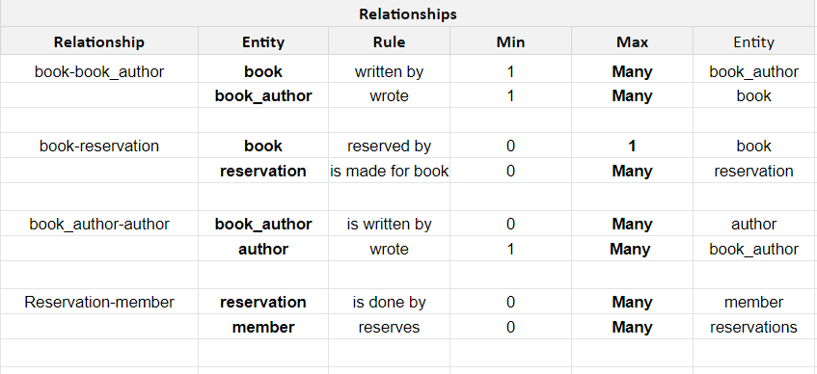
Requirements

Slide 4
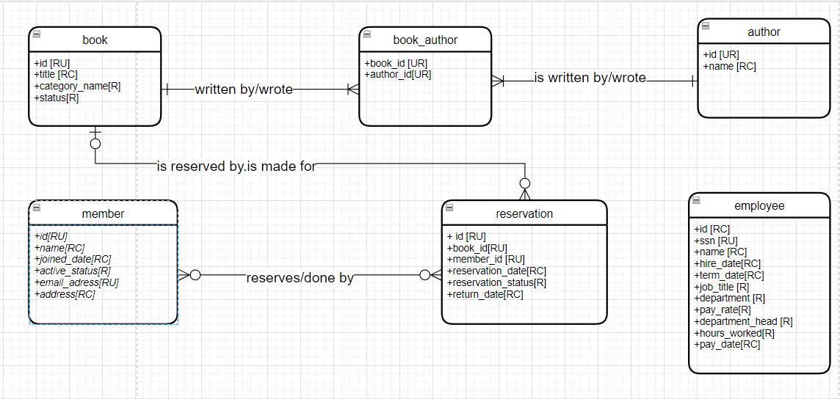
Conceptual
Model

Slide 5
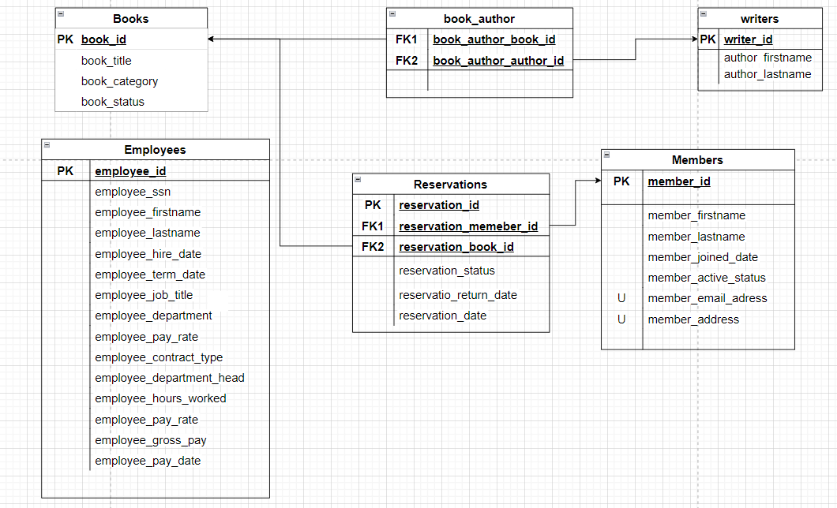
Logical Model

Slide 6
User Stories
As an Member I should be able to…
View all the books.
View all the availability of books
View past reservations
Reserve new books
As an Employee I should be able to…
Also enter in how much hours you worked for a given day, to get it approved by the supervisor

Slide 7
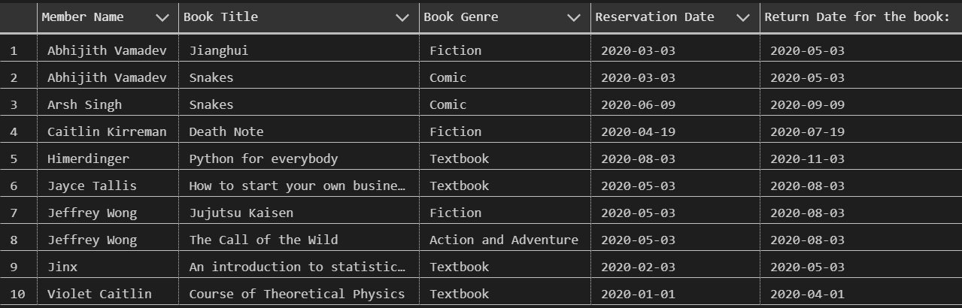
Views
Find all the reserved books
create view view_reserved_books as
select m.member_firstname + ' ' + m.member_lastname as 'Member Name',
b.book_title as 'Book Title', b.book_category_name as 'Book Genre',
r.reservation_date as 'Reservation Date',
r.reservation_return_date as 'Return Date for the book: '
from reservations r
join members m on m.member_id = r.reservation_member_id
join books b on b.book_id = r.reservation_book_id
group by m.member_firstname, m.member_lastname, b.book_title, b.book_category_name, r.reservation_date, r.reservation_return_date
go

Slide 8
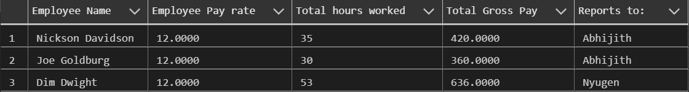
Views
2. Understand how many student workers are there,
create view view_library_cost_students as
select e.employee_firstname + ' ' + e.employee_lastname as 'Employee Name',
e.employee_payrate as 'Employee Pay rate',
e.employee_hours_worked as 'Total hours worked',
e.employee_payrate * e.employee_hours_worked as 'Total Gross Pay',
e.employee_department_head as 'Reports to: '
from employees e
where employee_jobtitle = 'Student Employee'
go

Slide 9

Views
3. Figure out the total cost of hiring students
create view students_cost as
select SUM(e.employee_hours_worked * e.employee_payrate) as 'Total Cost of Hiring Students'
from employees e
where employee_jobtitle = 'Student Employee'
go

Slide 10
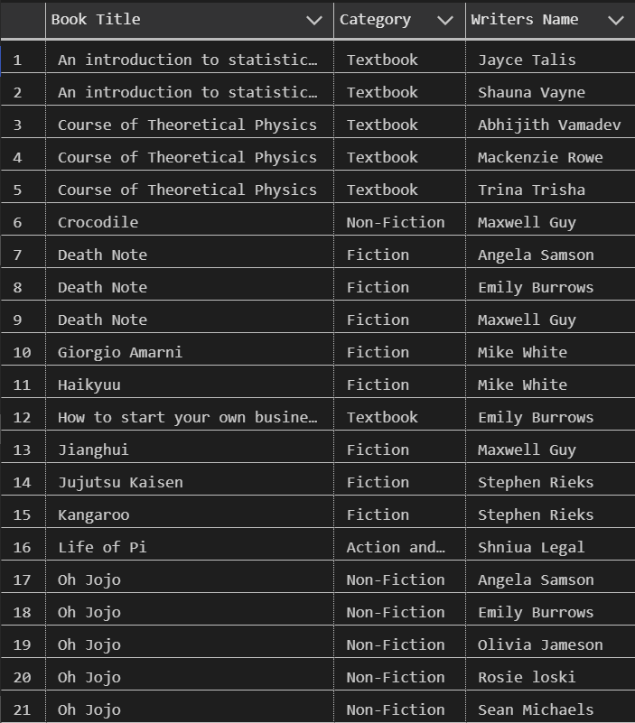
Views
4. Know all the books in the library and it’s authors
create view view_books_and_authors as
select b.book_title as 'Book Title',
b.book_category_name as 'Category',
w.writer_first_name + ' ' + w.writer_last_name as 'Writers Name'
from books b
join book_authors a on a.book_author_book_id = b.book_id
join writers w on w.writer_id = a.book_author_author_id
group by b.book_title, b.book_category_name, w.writer_first_name, w.writer_last_name
go

Slide 11

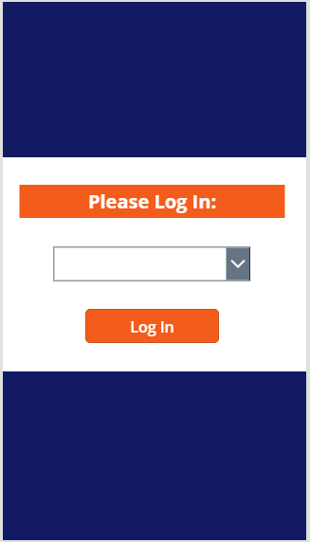
External Model Example Screens

Slide 12
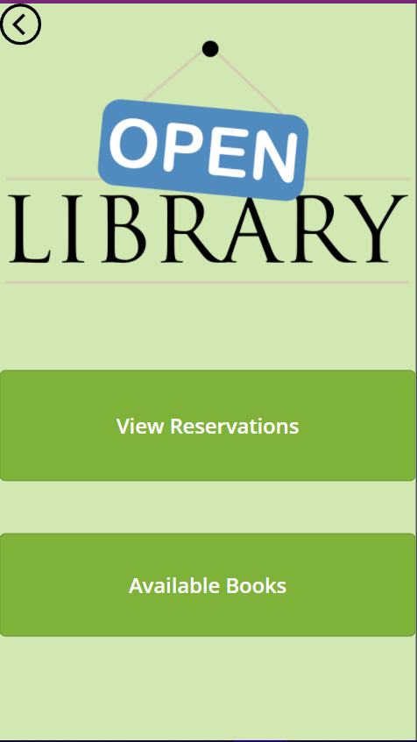
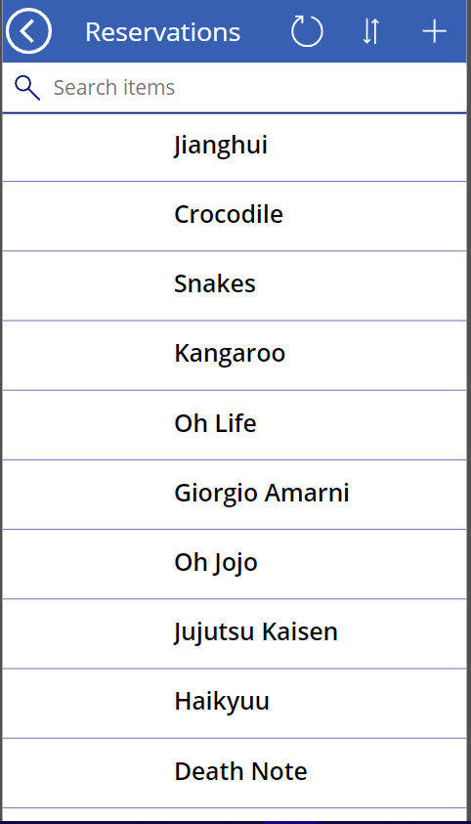
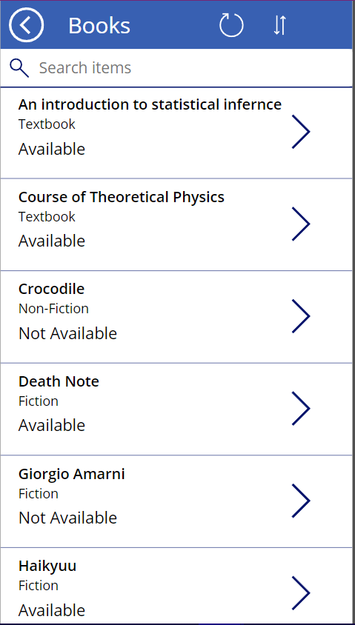
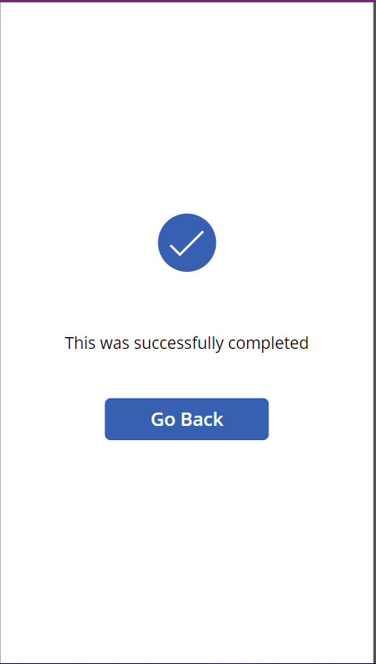
External Model Example Screens - Member Page

Slide 13
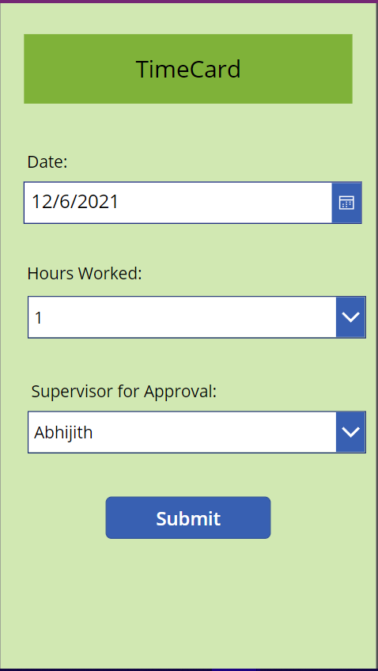
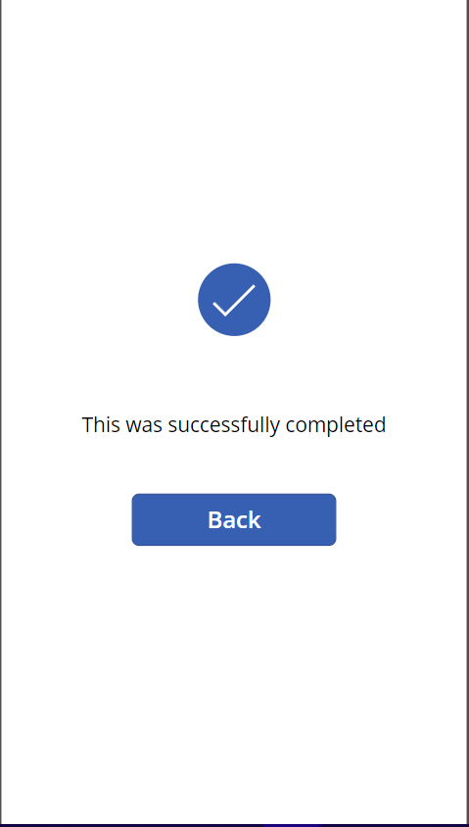
External Model Example Screens - Employee Page

Slide 14
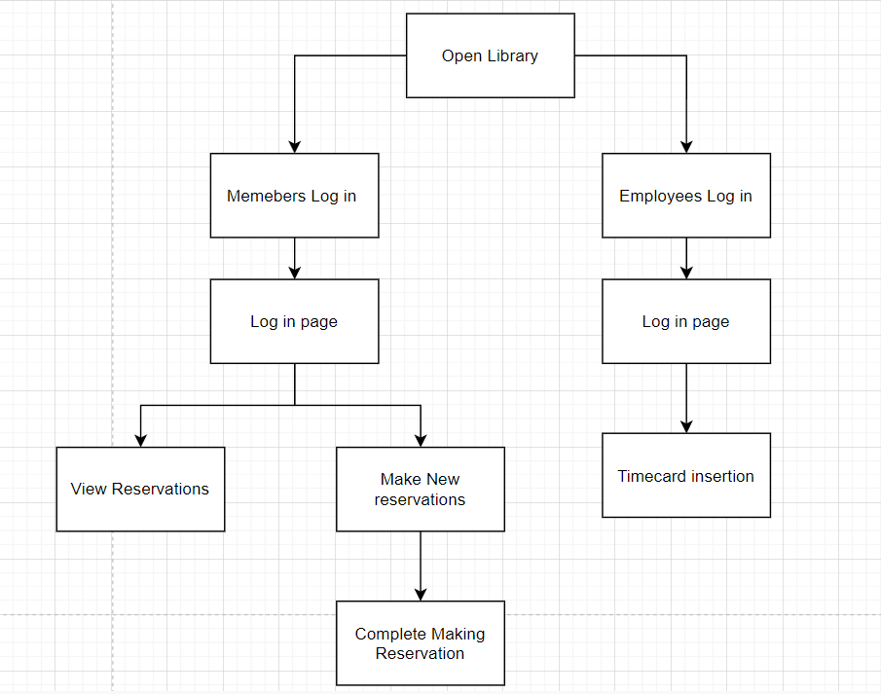
External Model Flow
Notes:
Leah

Slide 15
Team Reflection
Investigate ways to build out the database:
Add in information for Employees as well the reservation tab
Reservation fines
Add the ability to send the reserved online textbooks to a users’email
Membership fees
Add reviews for books, short summary and so on.
Powerapps:
Passwords for login for more security
VIew only current or past reservations
Supervisor should be able to view the timecards of each of their employees
Notes:
everyone

Slide 16
Thank You

